Slide 1
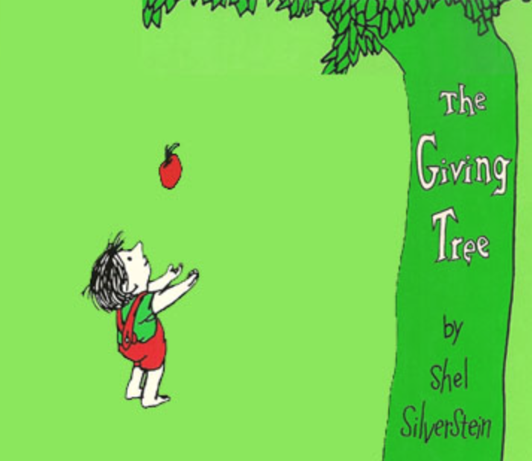
The Giving Tree
Level 2: 3rd-6th Grade
Created and Presented by Prestige Book Club

Slide 2
A Summary of The Giving Tree
But, as the boy ages, his needs change. Each time the boy visits, the tree gives him everything she can, including all her branches and her trunk. Reduced to a stump, the tree doesn't think she has anything left to give when the boy returns once again, this time as an old man. But it turns out a stump is just what the old man needs to sit down and get a little rest. So he does, and the tree is happy.
The story starts with a boy and his BFF, who just happens to be a tree. Every day the boy climbs the tree, eats the tree's apples, and sleeps in the tree's shade, and both the boy and the tree are happy with this arrangement.

Slide 3
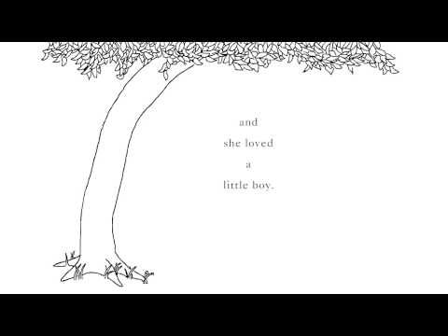

Slide 4
1. How did the tree feel about the little boy?
She hated him.
She loved him.
She thought he was boring.
She thought he was annoying.
2. Which is NOT something the little boy did on the tree?
Played king of the forest
Slept in her shade
Made leaf crowns
Sang her songs
3. The boy grew older. How did the tree feel?
angry
happy
lonely
excited
4. The tree gave the boy apples. She gave them to the boy
to eat.
to sell.
to throw.
to make juice.

Slide 5
5. The boy stayed away for a long time. How did that make the tree feel?
sad
angry
happy
excited
6. The boy cut branches from the tree. He cut the branches to
build a fire.
build a house.
make a statue.
make a craft project.
7. The boy cut down the tree's trunk. He used it to
build a fire.
build a boat.
build a house.
build a tree fort.
8. The last time the boy came back, he was too to do anything.
sad
old
happy
excited

Slide 6
9. The boy used the tree's stump to
carve.
stand on.
hold his TV.
sit and rest.
10. How did the tree feel at the end of the book?
sad
angry
happy
lonely
3
4
2
5
1
6

Slide 7
The Gift of Giving
Can you see how the tree is happy but the boy is not? The tree is happy because she is able to give the boy what he wants. The boy gets what he wants and at first he may be happy. However, in the end these gifts do not manage to keep him happy. Giving, and making people that you love happy, can be more rewarding than receiving any gift.
A
B
C

Slide 8
Self Sacrifice
The tree gives up a lot for the boy - her apples, branches and even her trunk. To make people that you love happy you may need to give something up which is important to you. For example, to make your brother happy you sometimes need to share your favourite toy with him.

Slide 9
Thank you for Joining Us Today!!

Slide 10
Tree Infographics
Mars
Jupiter
Venus
Saturn
Neptune
Despite being red, Mars is a cold place
Jupiter is the biggest planet of them all
Venus has a very poisonous atmosphere
Saturn is the biggest planet of them all
Neptune is the farthest planet from the Sun

